Slide 1
CS 347 (M) TAKE HOME QUIZ - 3
Mantri Krishna Sri Ipsit
180070032

Slide 2
PROBLEM STATEMENT
Consider two threads A and B that perform two operations each. Let the operations of thread A be A1 and A2; let the operations of thread B be B1 and B2. We require that threads A and B each perform their first operation before either can proceed to the second operation. That is, we require that A1 be run before B2 and B1 before A2

Slide 3
Approaches Variables Used
Semaphores
A1Done
B1Done
Cond. Variables
A1Done
B1Done
Boolean Variables
a1
a1
Locks
mutex

Slide 4
Using Semaphores Incorrect Solution
sem A1Done = 0
// Thread A
A1
down(B1Done)
up(A1Done)
A2
Sem B1Done = 0
// Thread B
B1
down(A1Done)
up(B1Done)
B2
Deadlock Condition!

Slide 5
Using Semaphores Correct Solution
sem A1Done = 0
// Thread A
A1
down(B1Done)
up(A1Done)
A2
Sem B1Done = 0
// Thread B
B1
up(B1Done)
down(A1Done)
B2

Slide 6
Using Conditional Variables Incorrect Solution
// Thread A
A1
acquire(mutex)
while(b1 == 0)
wait(B1Done, mutex)
a1 = 1
signal(A1Done)
release(mutex)
A2
// Thread B
B1
acquire(mutex)
while(a1 == 0)
wait(A1Done, mutex)
b1 = 1
signal(B1Done)
release(mutex)
B2
Deadlock Condition!

Slide 7
Using Conditional Variables Correct Solution
// Thread A
A1
acquire(mutex)
while(b1 == 0)
wait(B1Done, mutex)
a1 = 1
signal(A1Done)
release(mutex)
A2
// Thread B
B1
acquire(mutex)
b1 = 1
signal(B1Done)
while(a1 == 0)
wait(A1Done, mutex)
release(mutex)
B2

Slide 8
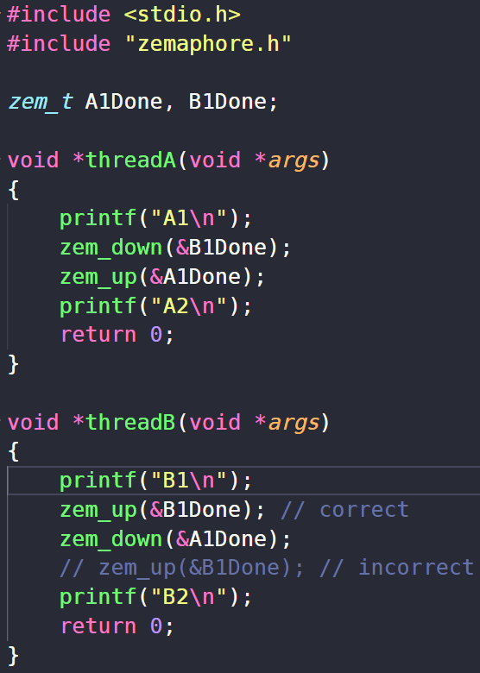
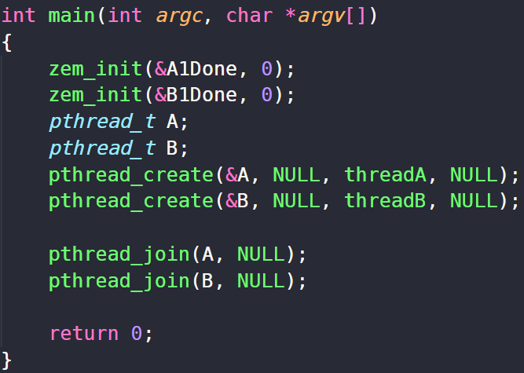
Code Semaphores

Slide 9
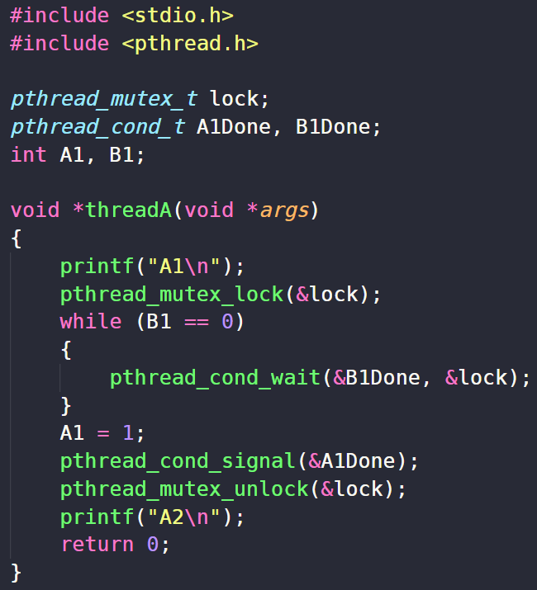
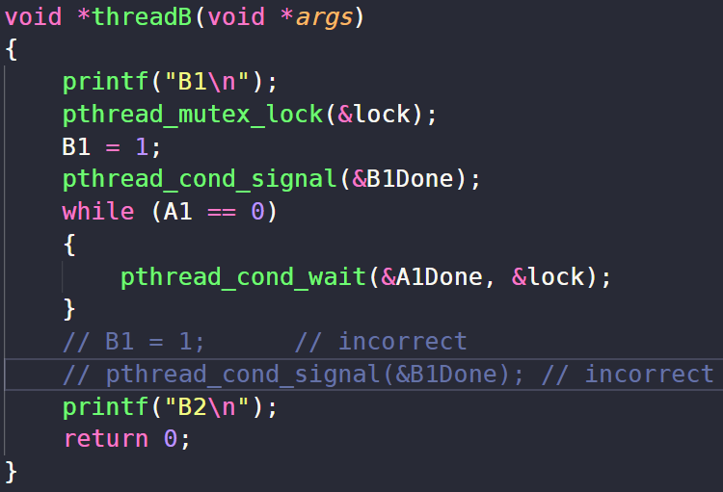
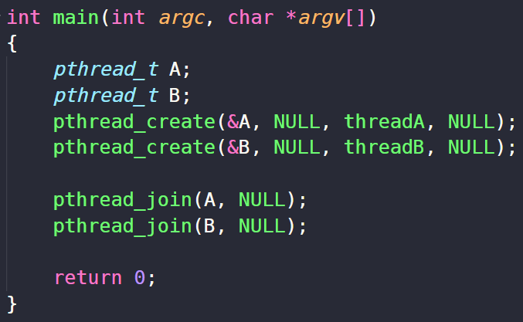
Code Conditional Variables

